Slide 1

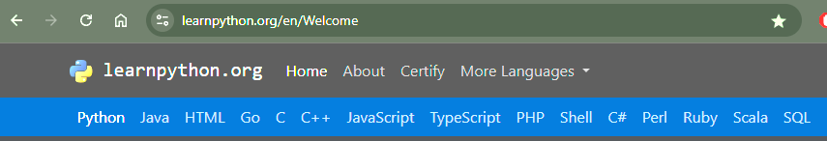
Learnpython.org
A course review by Elliot Cooke

Slide 2





Today

Slide 3
What is it?

Slide 4
Context & Relevance
Is it clear why you’re learning each topic?
Are real‑world use cases or analogies provided?
2

Slide 5
Course Structure
Is the curriculum ordered logically (prereqs before advanced topics)?
Are topics grouped clearly rather than scattered?
5

Slide 6
Content Quality
Are the explanations accurate, clear, and free of errors?
Do exercises and examples reinforce core concepts?
9

Slide 7
Flow & Interactivity
Do quizzes/tutorials match what was just taught?
Is there enough practice to cement learning before moving on?
Are there hands‑on labs, interactive code editors, or peer exercises?
Does the course ask you to actively code every step?
6

Slide 8



The best bit

Slide 9
Pacing
Is the speed appropriate, never too slow (boring) or too fast (overwhelming)?
Does energy stay consistent across the full runtime?
6

Slide 10
Production & Medium
Is the UI smooth, intuitive to navigate?
Is any audio/video on screen detracting or badly edited?
7

Slide 11
Value
Does it feel “premium” enough that you wouldn’t mind paying?
Is it worth the price?
8

Slide 12
Je ne sais quoi
2

Slide 13



Recap

Slide 14
Summary
Category | LearnPython.org | (The next course review will go here)
Context & Relevance | 2
Course Structure | 5
Content Quality | 9
Flow & Interactivity | 6
Pacing | 6
Production & Medium | 7
Value | 8
Je ne sais quoi | 2
Total | 45 / 75

Slide 15




Improvement suggestions

Slide 16
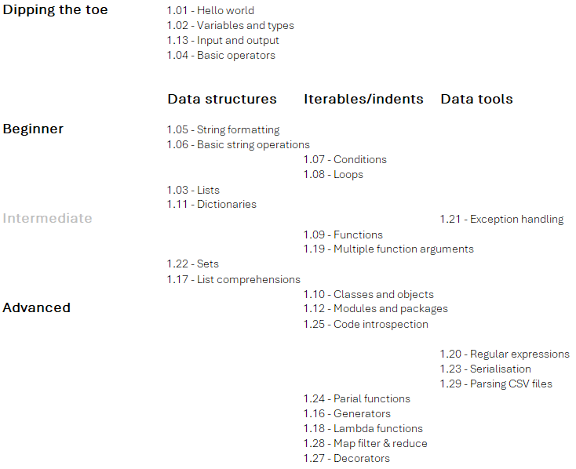
https://github.com/ElliotCookie

